Slide 2
Overview
Part 1 – Datapaths
Part 2 – A Simple Computer
Part 3 – Multiple Cycle Hardwired Control
  Single Cycle Computer Issues
  Modifications to Datapath
  Modifications to Control
  Sequential Control Design

Slide 3
Single-Cycle Computer Issues
Shortcoming of Single Cycle Design
  Complexity of instructions executable in a single cycle is limited
  Accessing both an instruction and data from a simple single memory impossible
  A long worst case delay path limits clock frequency and the rate of performing instructions
Handling of Shortcomings
  The first two shortcomings can be handled by the multiple-cycle computer discussed here
  The third shortcoming is dealt with by using a technique called pipelining described in Chapter 12

Slide 4
Multiple-Cycle Computer
Converting the single-cycle computer into a multiple-cycle computer involves:
  Modifications to the datapath/memory
  Modification to the control unit
  Design of a multiple-cycle hardwired control
The block diagram of the single-cycle SC architecture is given on the next slide for use in developing the multiple-cycle SC architecture

Slide 5
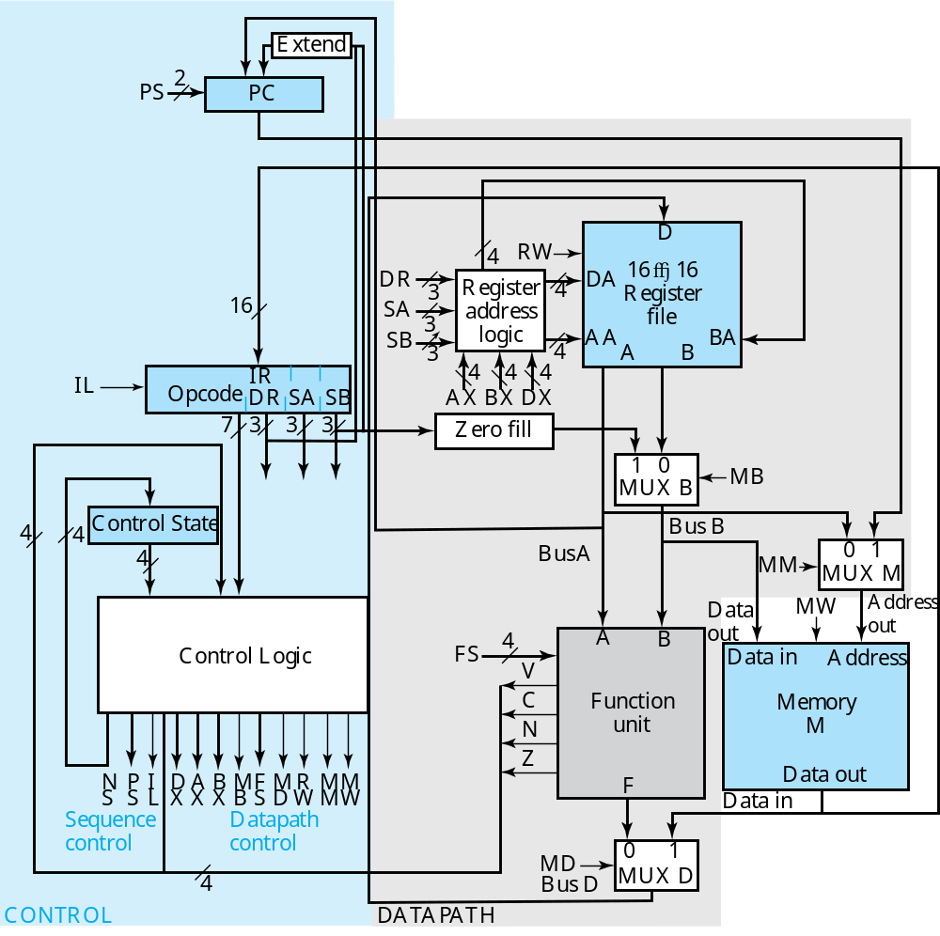

Slide 6
Datapath Modifications
Modifications appear on the next slide
Use a single memory for both instructions and data
  Not essential to the multiple-cycle design, but done to illustrate the concept
  Requires new MUX M with control signal MM to select the instruction address from the PC or the data address
  Requires path from Memory Data Out to the instruction path in the control unit

Slide 7
New Instruction Path
Inst. & Data Address Mux
Inst. & Data Memory

Slide 8
Datapath Modifications (continued)
To hold operands between cycles, need additional registers
  Add 8 temporary storage registers to the Register File
    Register File becomes 16 x 16
    Addresses to Register File increase from 3 to 4 bits
  Register File addresses come from:
    The instruction for the Storage Resource registers (0 to 7)
    The control word for the Temporary Storage registers (8 to 15)
    The control word specifies the source for Register File addresses
  Add Register Address Logic to the Register File to select the register address sources
  Three new control fields for register address source selection and temporary storage addressing: DX, AX, BX

Slide 9
Register Address Logic
16 x 16 Register File
Inst. & Data Address Mux

Slide 10
Control Unit Modifications
Must hold instruction over the multiple cycles to draw on instruction information throughout instruction execution
  Requires an Instruction Register (IR) to hold the instruction
    Load control signal IL
  Requires the addition of a "hold" operation to the PC since it only counts up to obtain a new instruction
    New encoding for the PC operations uses 2 bits

Slide 11
Add "hold" operation
Instruction Register IR

Slide 12
Sequential Control Design
In order to control microoperations over multiple cycles, a Sequential Control replaces the Instruction Decoder
  Input: Opcode, Status Bits
  Output: Control Word (Modified Datapath Control part)
  Control State
  Next State: Control Word (New Sequencing Control part)
  Consists of (see next slide):
    Register to store the Control State
    Combinational Logic to generate the Control Word (both sequencing and datapath control parts)
  The Combinational Logic is quite complex so we assume that it is implemented by using a PLA or synthesized logic and focus on ASM level design

Slide 13
Control State Register
Combinational Control Logic
New/ Modified Control Word

Slide 14
Control Word
27
24
23
22
21
20
17
16
13
12
9
8
7
4
3
2
1
0
NS
PS
I
DX
AX
BX
M
FS
M
R
M
M
L
B
D
W
M
W
Sequencing
Datapath
Datapath part: fields DA, AA, and BA replaced by DX, AX, and BX, respectively, and field MM added
  If the MSB of a field is 0, e.g., AX = 0XXX, then AA is 0 concatenated with 3 bits obtained from the SA field in the IR
  If the MSB of a field is 1, e. g. AX = 1011, then AA = 1011
Sequencing part:
  IL controls the loading of the IR
  PS controls the operations of the PC
  NS gives the next state of the Control State register
    NS is 4 bits, the length of the Control State register - 16 states are viewed as adequate for this design

Slide 15
Encoding for Datapath Control
DX
AX
BX
Code
MB
Code
FS
Code
MD
R
W
MM
MW
Code
R
[DR]
R
[SA]
R
[SB]
0
XXX
Register
0
←
0000
FnUt
No
Address
No
0
F A
write
Out
write
R
8
R
8
R
8
1000
Constant
1
←
+
0001
Data In
Write
PC
Write
1
F A
1
R
9
R
9
R
9
1001
←
+
0010
F A
B
R
10
R
10
R
10
1010
Unused
0011
R
11
R
11
R
11
1011
Unused
0100
←
+
B
+
1
R
12
R
12
R
12
1100
F A
0101
R
13
R
13
R
13
1101
←
–
0110
F A
1
R
14
R
14
R
14
1110
Unused
0111
R
15
R
15
R
15
1111
←
^
1000
F A
B
←
v
1001
F A
B
←
+
B
1010
F A
←
1011
F A
←
1100
F B
F
←
sr
B
1101
F
←
sl
B
1110
Unused
1111

Slide 16
Encoding for Sequencing Control
NS
PS
IL
Ne
xt State
Action
Code
Action
Code
Gives next state
Hold PC
00
No load
0
of Control State
Inc PC
01
Load IR
1
Register
Branch
10
J
ump
11

Slide 17
SMDs for Sequential Control
An instruction requires two steps:
  Instruction fetch – obtaining an instruction from memory
  Instruction execution – the execution of a sequence of microoperations to perform instruction processing
  Due to the use of the IR, these two steps require a minimum of two clock cycles
ISA: Instruction Specifications and SMD for the instructions (that all require two clock cycles) are given on the next four slides.

Slide 18
ISA: Instruction Specifications (for reference only)
I
n
st
ruction Speci
fications for the Simple
Comput
er - Part 1
St
a
t
u
s
Instr
u
ctio
n
O
pc
ode
Mnem
on
ic
Form
a
t
D
escrip
tion
Bits
Move A
0000000
MO
V
A
RD
,RA
R
[DR]
←
R[SA
]
N
,
Z
Increment
0000001
INC
R
D
,
RA
R[DR]
←
R
[
SA]
+ 1
N
,
Z
Add
0000010
ADD
R
D
,
RA,RB
R
[DR]
←
R[SA
]
+ R[
SB]
N
,
Z
Subtr
a
ct
0000101
SUB
R
D
,
RA,RB
R
[DR]
←
R[SA
]
−
R
[
SB]
N
,
Z
D
e
crement
0000110
DEC
R
D
,
RA
R[DR]
←
R[SA
]
−
1
N
,
Z
AND
0001000
AND
R
D
,
RA,RB
R
[DR]
←
R[SA
]
∧
R[SB
]
N
, Z
O
R
0001001
OR
RD
,RA,RB
R[DR]
←
R[SA
]
∨
R[SB
]
N
, Z
Exclusive OR
0001010
XOR
R
D
,
RA,RB
R
[DR]
←
R[SA
]
⊕
R[SB]
N
,
Z
NO
T
0001011
NO
T
R
D
,
RA
R[DR]
←
R[SA
]
N,
Z
SMD on Next Slide

Slide 19
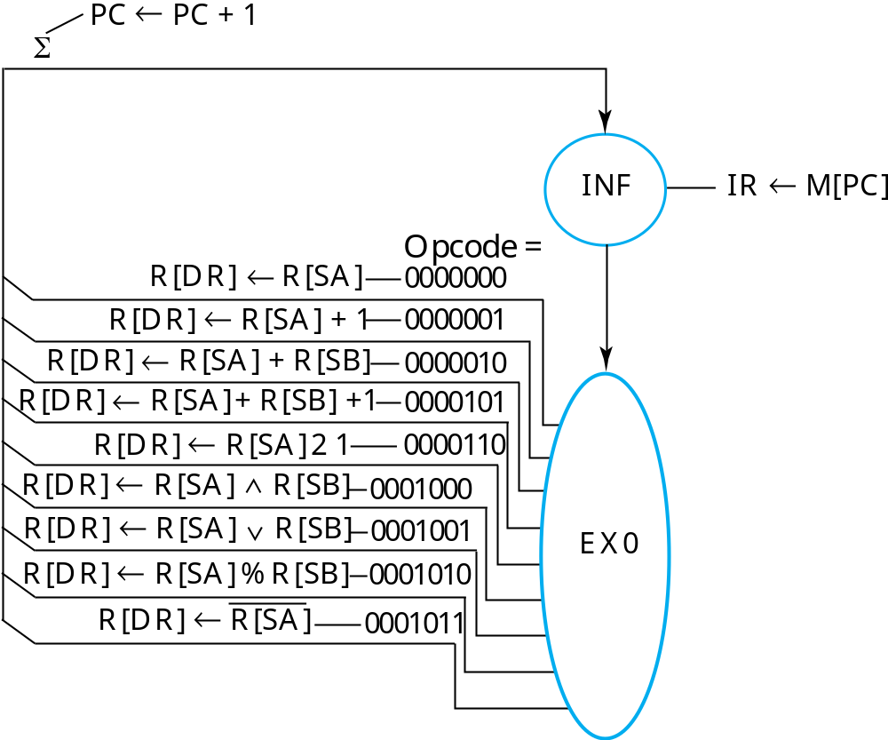
SMD for Two-Cycle Instructions - Part 1

Slide 20
ISA: Instruction Specifications (for reference only)
I
n
st
ruction Speci
fications for the Simple
Comput
er - Part 2
St
a
t
u
s
Instr
u
ctio
n
O
pc
ode
Mnem
on
ic
Form
a
t
D
escrip
tion
Bits
Move B
0001100
MO
VB
RD
,RB
R
[DR]
←
R[SB]
Shift Right
0001101
SHR
R
D
,
RB
R[DR]
←
sr
R[SB]
Shift Left
0001110
SHL
R
D
,
RB
R[DR]
←
sl
R[SB]
Load Imm
e
diate
1001100
LDI
R
D
,
O
P
R[DR]
←
zf OP
Add Immediate
1000010
ADI
R
D
,
RA,OP
R
[DR]
←
R[SA]
+ zf
OP
Load
0010000
LD
RD
,RA
R
[DR]
←
M[
SA
]
Store
0100000
ST
RA,RB
M
[SA]
←
R[SB]
Branch
on
Zero
1100000
BRZ
R
A,AD
if (R[
S
A] =
0) PC
←
PC
+ s
e
A
D
Branch
on
Negative
1100001
BRN
R
A,AD
if (R[
S
A] <
0) PC
←
PC
+ s
e
A
D
J
u
mp
1110000
JMP
R
A
P
C
←
R[SA
]

Slide 21
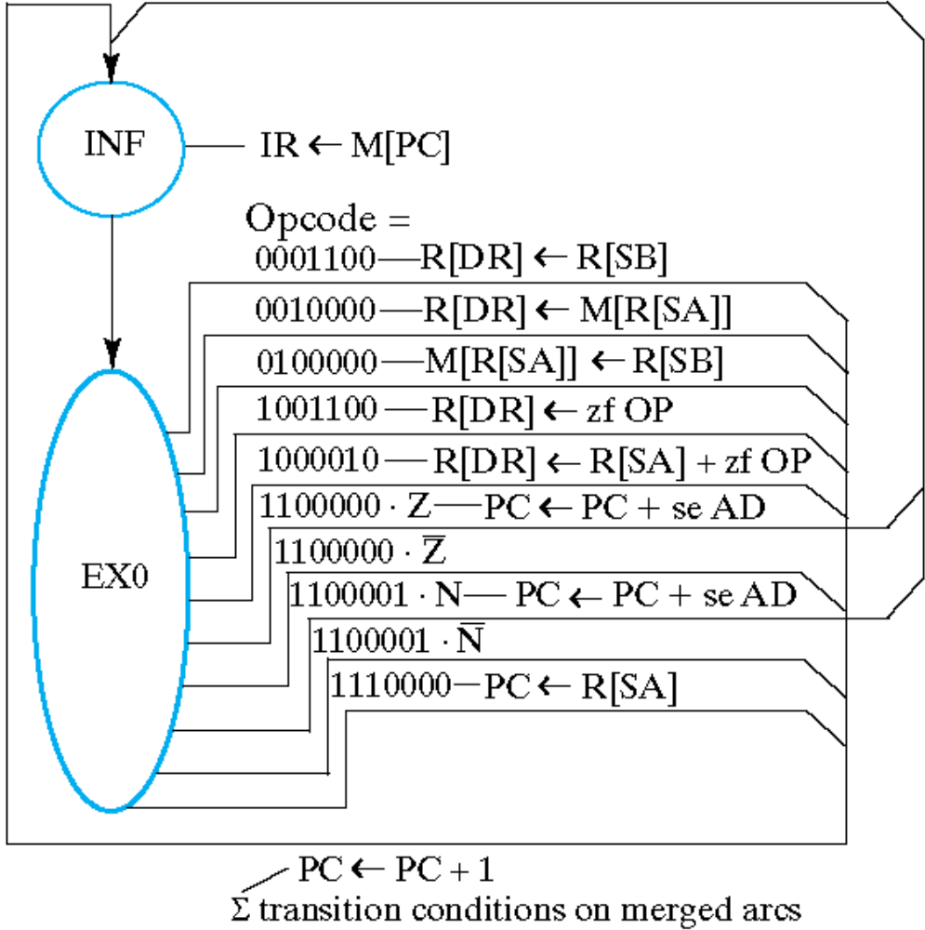

SMD for 2-Cycle Instructions – Part 2
Instruction Fetch Portion Duplicated From Part 1

Slide 22
State Table for 2-Cycle Instructions
I
n
p
u
t
s
N
e
x
t
O
u
t
p
u
t
s
S
t
a
t
e
s
t
a
t
e
I
P
M
M
R
M
M
O
p
c
o
d
e
V
C
N
Z
L
S
D
X
A
X
B
X
B
F
S
D
W
M
W
C
o
m
m
e
n
t
s
I
N
F
X
X
X
X
X
X
X
X
X
X
X
EX0
1
00
X
X
X
X
X
X
X
X
X
X
X
X
X
X
X
X
X
X
0
1
0
I
R ←
M
[
PC
]
E
X
0
0
000000
X
X
X
X
INF
0
01
0
X
X
X
0
X
X
X
X
X
X
X
X
0000
0
1
X
0
M
O
V
A
R
[DR
]
←
R
[SA]*
E
X
0
0
000001
X
X
X
X
INF
0
01
0
X
X
X
0
X
X
X
X
X
X
X
X
0001
0
1
X
0
I
N
C
R
[DR
]
←
R
[S
A
]
+
1*
E
X
0
0
000010
X
X
X
X
INF
0
01
0
X
X
X
0
X
X
X
0
X
X
X
0
0010
0
1
X
0
A
D
D
R
[DR
]
←
R
[S
A
]
+
R
[S
B
]*
E
X
0
0
000101
X
X
X
X
INF
0
01
0
X
X
X
0
X
X
X
0
X
X
X
0
0101
0
1
X
0
S
U
B
R
[DR
}
←
R
[S
A
]
+
R
[
S
B
]
+
1*
E
X
0
0
000110
X
X
X
X
INF
0
01
0
X
X
X
0
X
X
X
X
X
X
X
X
0110
0
1
X
0
D
E
C
R
[DR
]
←
R
[S
A
]
+
(
-
1)
*
E
X
0
0
001000
X
X
X
X
INF
0
01
0
X
X
X
0
X
X
X
0
X
X
X
0
1000
0
1
X
0
A
N
D
R
[DR
]
←
R
[SA]
^
R
[S
B
]*
E
X
0
0
001001
X
X
X
X
INF
0
01
0
X
X
X
0
X
X
X
0
X
X
X
0
1001
0
1
X
0
O
R
R
[DR
]
←
R
[SA]
v
R
[S
B
]*
E
X
0
0
001010
X
X
X
X
INF
0
01
0
X
X
X
0
X
X
X
0
X
X
X
0
1010
0
1
X
0
X
O
R
R
[DR
]
←
R
[SA]
+
R
[S
B
]*
E
X
0
0
001011
X
X
X
X
INF
0
01
0
X
X
X
0
X
X
X
X
X
X
X
X
1011
0
1
X
0
N
O
T
R
[DR
]
←
R
[
S
A
]
*
E
X
0
0
001100
X
X
X
X
INF
0
01
0
X
X
X
X
X
X
X
0
X
X
X
0
1100
0
1
X
0
M
O
V
B
R
[DR
]
←
R
[S
B
]*
E
X
0
0
010000
X
X
X
X
INF
0
01
0
X
X
X
0
X
X
X
X
X
X
X
X
X
X
X
X
1
1
0
0
L
D
R
[DR
]
←
M
[
R
[SA]]*
E
X
0
0
100000
X
X
X
X
INF
0
01
X
X
X
X
0
X
X
X
0
X
X
X
0
X
X
X
X
X
0
0
1
S
T
M
[
R
[SA]]
←
R
[S
B
]*
E
X
0
1
001100
X
X
X
X
INF
0
01
0
X
X
X
X
X
X
X
X
X
X
X
1
1100
0
1
0
0
LDI
R
[DR
]
←
z
f
OP
*
E
X
0
1
000010
X
X
X
X
INF
0
01
0
X
X
X
0
X
X
X
X
X
X
X
1
0010
0
1
0
0
ADI
R
[DR
]
←
R
[S
A
]
+
z
f
OP
*
E
X
0
1
100000
X
X
X
X
X
X
X
X
X
X
X
X
X
X
X
X
←
1
I
N
F
0
1
0
0
0000
0
0
0
B
R
Z
PC
PC
+
s
e
A
D
E
X
0
1
100000
X
X
X
X
X
X
X
X
X
X
X
X
X
X
X
X
←
0
I
N
F
0
0
1
0
0000
0
0
0
B
R
Z
PC
PC
+
1
E
X
0
1
100001
X
X
X
X
X
X
X
X
X
X
X
X
X
X
X
X
←
1
INF
0
10
0
0000
0
0
0
B
R
N
PC
PC
+
s
e
A
D
E
X
0
1
100001
X
X
X
X
X
X
X
X
X
X
X
X
X
X
X
X
←
0
INF
0
01
0
0000
0
0
0
B
R
N
PC
PC
+
1
E
X
0
1
110000
X
X
X
X
INF
0
11
X
X
X
X
0
X
X
X
X
X
X
X
X
0000
X
0
0
0
J
M
P
PC
←
R
[S
A
]
*
F
o
r
thi
s
state
a
n
d
i
n
put
combinati
o
n,
PC
¬
PC
+
1
als
o
oc
cur
s
.

Slide 23
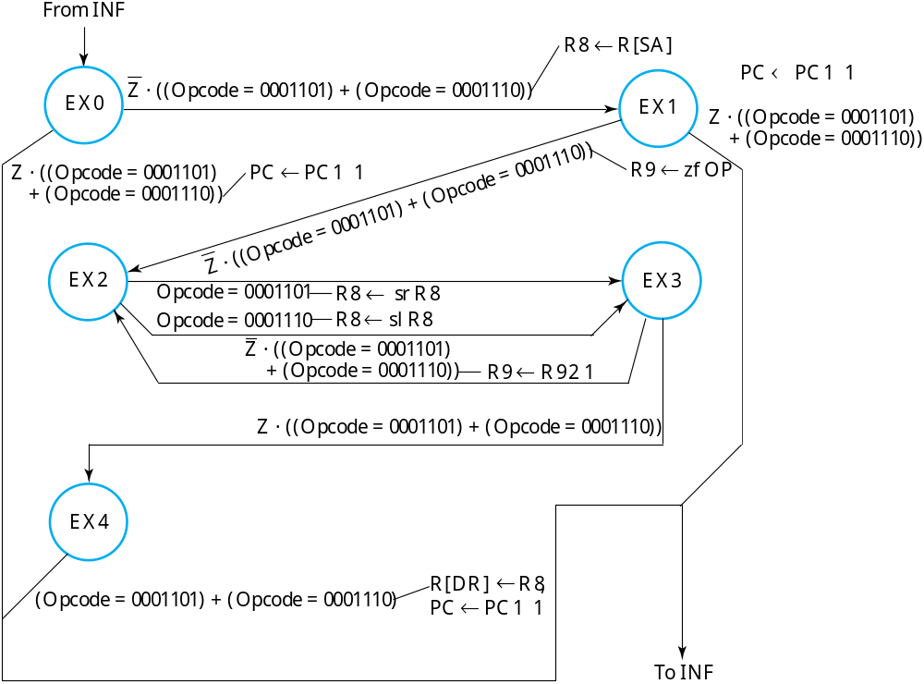
SMD for Right Shift and Left Shift Multiple

Slide 24
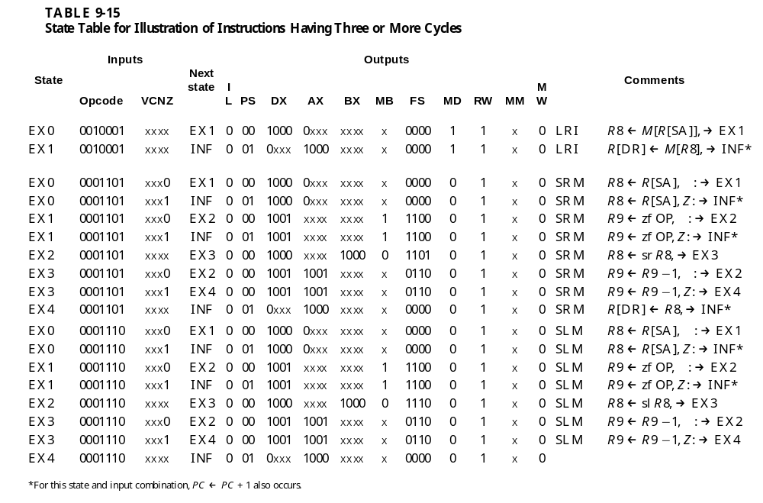
State Table For Right and Left Shift Multiple

Slide 25
Terms of Use
All (or portions) of this material © 2008 by Pearson Education, Inc.
Permission is given to incorporate this material or adaptations thereof into classroom presentations and handouts to instructors in courses adopting the latest edition of Logic and Computer Design Fundamentals as the course textbook.
These materials or adaptations thereof are not to be sold or otherwise offered for consideration.
This Terms of Use slide or page is to be included within the original materials or any adaptations thereof.

